Slide 1
LNPs and Nano Delivery Systems – Challenges in Formulation Design & Manufacture Dr Juliana Haggerty Head of Centre of Excellence – Lipid Nanoparticle, CPI.

Slide 2
Notes:
At CPI, we do not invent, and we do not manufacture products. We operates in the area between research and invention and the commercial market. We help companies to apply research and new ideas to manufacturing processes and offer support to navigate routes to commercialization before they are launched into the market.

Slide 3
Notes:
We do all this using our integrated innovation services. This is a unique collection of activities that allows us to drive your innovation forward and get your product or process to market quickly and cost effectively.
Industry Relevant Expertise and Assets; We have over £170m worth of industry relevant assets alongside over 400 highly skilled experts to deliver product and process development, proof of concept and scale up activities.
Expertise in securing funding and investment for clients; We have deep expertise in securing funding from public and private sources for our partners. We have a core group dedicated to scoping projects, identifying funding, building consortia, developing proposals and understanding the submissions process.
Knowledge and application of innovation process; We have been helping companies to innovate for over 15 years. We understand that taking your idea through to commercialisation may require expertise far beyond your scientific application area. Successful innovation needs scale-up advice and technical problem-solving; regulatory expertise, IP strategy and legal support; a complete supply chain – from raw materials to finished product; and a well-considered pricing, sales and marketing strategy. We help to guide you through every element of the innovation process reducing risk and speeding up time to market.

Slide 4
Developing our RNA and LNP Capability

Slide 5
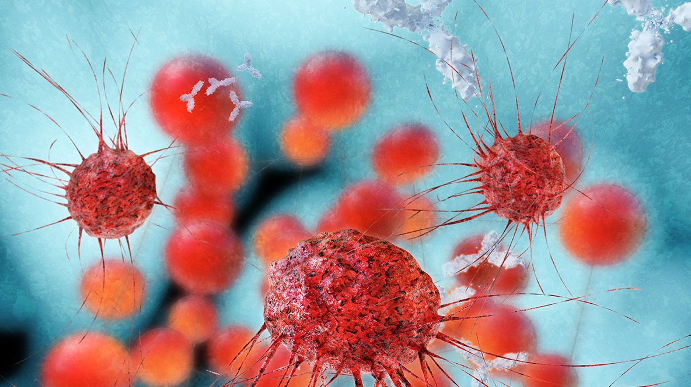
Advancing nanomedicine production
Accelerating the development of nanomedicines
Advancing the use of nanomedicines as targeted drugs to maximise efficacy and minimise side effects, for example in the treatment of cancer, or for use in vaccines.
OUTCOMES AND IMPACT
Developing a unique test facility to support the microfluidic scale-up of difficult-to-produce nanomedicines
Collaborative R&D
2 years
£765,372
Manufacturing process
Purification
Isolation
In-vitro and in-vivo testing
Characterisation
Notes:
Relevant to:
Pharmaceuticals
Project: ‘MICROSUN’
Drive:
Move from batch production to continuous manufacturing. Batch Processes are often composed of multiple steps (separate production, purification and characterisation), scale up poorly and reproducibility is an major issue
Evaluate the benefits of in-process monitoring tools on control of product quality attributes and speed of process development
Demonstrate process optimisation and scale-up of nanoformulations .Transfer to GMP Manufacturing
Overview of case study:
MicroSUN (Microfluidic Scale-Up of Nanoformulations) is a strategic formulation project that partners with academics and industrial companies to develop CPI as a national open-access facility for the rapid scale-up of liquid nanoformulations to support the UK pharmaceutical industry (see slide 2).
Pilot Line
This will be achieved by setting up a continuous system with in-line purification and at-line analysis to give real-time product information (Figure 2). This real-time product tracking will give a continuous production of in-specification product post-filtration.
Custom Built TFF
CPI have developed a custom built tangential flow filtration (TFF) system to allow continuous filtration of the Blaze product (Figure 3). This uses peristaltic pumps to restrict the retentate flow as opposed to a back pressure valve in the traditional TFF set up. This allows faster filtration that is easier to scale-up. This does mean however, that the TFF process requires further optimisation as there is no pressure feedback into the system.

Slide 6
Advancing RNA Vaccine production
Development, manufacture and supply of a saRNA COVID-19 Vaccine
CPI was asked by the UK Vaccine Taskforce to support the nucleic acid vaccine workstream.
How we helped
CPI worked with Prof. Robin Shattock’s team to tech transfer in a manufacturing process to the UK for saRNA synthesis, purification and encapsulation.
CPI re-developed process steps to enable scale up and ran the synthesis process at a 1L scale (the largest scale RNA vaccine manufacture in the UK) and verified in process and QC tests.
All product quality specifications were met.
A parallel programme of work established GMP manufacturing space in Darlington, along with associated Quality Management system.
A GMP Supply Base readiness programme was completed to enable future UK GMP manufacture and supply of RNA vaccines.
“On VTF advice, the government provided £8.6m of funding for the CPI in Darlington based on its expertise in biotherapeutic and nucleic acid manufacturing processes, nano particle encapsulation and formulation … The VTF funding creates a UK centred GMP supply chain for the manufacture of mRNA vaccines and an anchor for research and innovation which will accelerate improvements of this novel technology, such as improved stability at room and refrigerated temperatures and reduced cost of goods.”
UK Vaccine Taskforce 2020
Achievements and Future Strategy End of year report
Government funded R&D
9 months
£8.6 million
Notes:
Relevant to:
Pharmaceuticals
Project: Development, manufacture and supply of a saRNA COVID-19 Vaccine
Overview of case study:
At the start of the coronavirus pandemic, there was a number of options studied for the development and manufacture of treatments and vaccines. Within the UK, there were many parallel tracks for vaccine development including the Oxford AZ vaccine that is currently being rolled out, as well as a vaccine based on Imperial College’s saRNA technology. Led by the UK Vaccine Task force, companies, universities and research and technology institutes worked on these parallel tracks to produce viable vaccines for clinical trials, as well as manufacturing routes and robust supply chains. CPI worked on the Imperial vaccine, transferring the technology from the Imperial lab to the larger scale production facilities at CPI’s National Biologics Manufacturing Centre (NBMC). CPI team developed the process steps to enable scale up of the vaccine production to a 4L batch size, although only a 1L process was run (which is still the largest scale RNA vaccine manufacture in the UK) as well as verified the quality of the RNA product through using advanced analytical characterisation. As a result, all product quality specifications were met.
Concurrently, the CPI team developed the GMP processes and Quality Management Systems required to produce vaccines for human use.
Project:
To scale up the Imperial saNRA vaccine
Innovation:
Scaled process to develop a novel saRNA SARS-CoV2 vaccine
Growth:
Developed and implemented QMS to enable GMP production at NBMC in Darlington which will enable CPI to provide RNA based vaccines in future, supports future pandemic resilience in the UK

Slide 7
CPI’s RNA Centre of Excellence
An end-to-end, world-class RNA and LNP research, development, and industrialisation capability for RNA Vaccines and Therapeutics.
Optimised RNA-LNP manufacturing platform
Training / skills packages
In house optimised platform manufacturing process
A range of online courses starting Q3 22 , plus bespoke training packages
Unique R&D capability across RNA and LNP
GMP manufacture
Expert teams and facilities to translate research ready for industrial application
The UK’s only RNA-LNP manufacturing facility, funded by the UK’s Vaccine Taskforce

Slide 8
Encapsulation into other delivery systems
PLGA microparticles for small molecules
PLGA/PLA NPs for small molecules
PLGA for targeted therapeutics
PEI-based NPs
Pol
3-component liposomes for small molecules
2-component cationic liposomes
4-component ionisable liposomes
Inorganic
Peptide
Polymeric
Liposome
Other delivery systems
dd
Novel peptide NPs for nucleic acids
Solid core gold NPs
Silica NPs for nucleic acids

Slide 9
CPI have developed, optimised and explored Critical Process Parameters in our LNP platform process to support R&D and GMP batches
RNA
Lipids
Encapsulation
Dilution
TFF
Final formulation
Final filtration
Storage

Slide 10
Increase in nanoparticle concentration
As the concentration of nanoparticles increases (both RNA and lipids):
Particle size increases
PDI and encapsulation efficiency remain constant
This offers flexibility to the LNP platform process, but may be limited by the size of the RNA being encapsulated
Increasing concentration of RNA/lipid on encapsulation

Slide 11
Different lipid systems
Changing the ionisable lipid and dialysing against buffer with cryoprotectant
This affects encapsulation and stability of LNPs, shown by particle size, PDI and encapsulation efficiency
*Around 600 nm
DLin-MC3-DMA
pKa 6.44
DLin-MC3-DMA
DLin-KC2-DMA
DLin-DMA
DLin-KC2-DMA
pKa 6.7
DLin-DMA
pKa 6.8

Slide 12
Limitations of LNP platform process
Develop process through R&D
But one size does not fit all for the platform process
Are you changing what you are encapsulating – siRNA, mRNA, saRNA, DNA?
Are you changing your lipid system? Or the molar ratios of the lipid system?
Change a critical parameter
Are you changing any excipients?
Are you changing equipment?
Establish a process
All of these can affect how a system encapsulates, performs downstream or the stability

Slide 13
The IntraCellular Drug Delivery Centre (ICDC)

Slide 14
Why IntraCellular Drug Delivery?
Rapidly improving biological understanding of disease >> range of new modalities to target previously undruggable targets. Often require a specific targeting and delivery technology to be effective medicines.
Modalities that might require a delivery system include:
Nucleic acid (e.g., mRNA and self amplifying RNA, siRNA and antisense oligos, gene editing technology such as CRISPR/Cas9, base or prime editing) or novel peptides, small molecules or proteins.
One of the leading technology platforms is Lipid NanoParticles (LNPs) and this will be the lead technology platform for our Centre, building capability that can be applied to other nano- delivery systems
Challenges
Thermostability needs improvement alongside alternative (to injection) delivery routes.
Payload transport and release in the body is very inefficient.
Delivery of nucleic acids beyond the liver is challenging, limiting therapeutic potential.
Prediction of immunogenicity, safety and adverse reactions is challenging.
Supply chains and manufacturing processes are immature.
Complex IP landscape and high licensing costs of current technology platforms.
Current in vitro models fail to accurately predict human immune response.

Slide 15
IntraCellular Drug Delivery Centre (ICDC) - Programme to start Jan 2023
Single front door Centre for companies/academics to access state of the art capabilities and expert support
Design, formulation, characterisation and manufacture of nano-delivery systems (NDS) for multiple payloads and targets
R&D programmes to solve challenges
Flexible industry engagement model – one to one (fee for service) or collaborative, multi-partner programmes
LNP Formulation Screening & Characterisation
Novel high throughput, automated workflow to screen payloads, ionisable/ cationic (off the shelf and novel synthesised) and stabilising lipids, formulation ratios, buffers/ excipients.
In depth workflow to analyse manufacture, safety and adverse reactions, biological performance and efficacy
Enhanced methods to enable in vitro-in vivo correlation
Current in vitro assays and models are not, always, predictive of immune response, efficacy, biodistribution, and adverse reactions in humans.
LNP Digital Manufacturing Grand Challenge
Supporting industry
A WP focussed on understanding the needs of the industrial and academic community, and designing appropriate whitepapers, guidance documents and training/ skills packages.
Opportunity for industry to join this pre-competitive programme through cash/ in kind contributions to shape programme and access outputs
This WP will look at co-culture systems, complex cell models and assays, and work retrospectively, using patient samples/ clinical data on patients that have received LNP encapsulated products to assess current and new tests.
This WP will also disseminate non confidential outputs from all partners.
Structured data captured in a cloud based data repository, and modelled to establish structure-function linkages
We will work with an industry partner to develop a QbD 4.0 software suite for nano medicines and demonstrate the approach on a PAT enabled LNP manufacturing line.

Slide 16
Partner Capabilities
University of Strathclyde
(Professor Yvonne Perrie)
Development of drug delivery systems to facilitate the delivery of drugs and vaccines, including liposomes and LNPs.
Definition of novel LNP compositions and understanding of lipid structure/function at a small scale to address nucleic acid-based drug delivery challenges.
Manufacture of drug delivery technologies including use of microfluidic manufacturing approaches
University of Liverpool
(Dr Neill Liptrott)
Understanding biological interactions of nanotechnology-enabled medicines and therapeutics.
Physical and chemical characterisation alongside assessment of the biocompatibility, immunomodulatory potential and risk of novel therapeutic strategies, supporting nanotherapeutics to clinical studies
Part of European Nanomedicine Characterisation Laboratory
CPI – Centre Lead
Core expertise in LNP formulation and manufacture across multiple manufacturing technologies (including microfluidic, T–piece)
Broad and deep formulation, materials and colloid science expertise and capability
LNP and nanoparticle characterisation
Significant capability and expertise in mRNA, saRNA and oligo development and manufacture
Digitalisation of manufacturing processes, including PAT, advanced process control, modelling and HT development
Imperial College London
(Prof Robin Shattock)
Experience in developing mRNA and saRNA vaccines, including LNP encapsulated, with a recent focus on a CV19 saRNA vaccine
Expertise in understanding the interaction of vaccines with the innate and adaptive immune system
Proven model systems to evaluate immune response: expression, immune activation, targeting and delivery (cells, skin explants, small animal, pig)
UK based RTO
Expertise in assessment of intracellular delivery via in-vitro animal and human cell models
in-vivo and ex-vivo biodistribution studies to show where LNP vaccines / therapeutics and other nanotherapeutics localise
Analysis of biological effect (both therapeutic and toxicological)

Slide 17
Flexible mechanism for Industry Engagement with the ICDC
Fee for service
Collaborative projects
Grand Challenges
Bespoke project with CPI, and other ICDC partners as required
Flexible scope and project size
Rapid initiation of projects
Can encompass a range of services including business and innovation support, consultancy, and lab-based projects
One-to-one with CPI or together with a larger consortium
Projects initiate after completion of a detailed funding protocol
We offer a bespoke service for bid development and grant landscape navigation
Transformative pre-competitive collaborative programmes
Triple helix of academia, industry and government
Potential programmes in Digital LNP manufacturing and enhanced assays for in vitro in vivo correlation
Best option for highly innovative projects you can’t fully fund yourself
Great mechanism to tackle major industry challenges
Offers flexibility and speed

Slide 18
Who the ICDC wants to support
Pharma and Biotech End Users developing vaccines/ therapeutics using LNP
CDMO and CRO developing services who wish to identify the best technologies/ approaches
RNA payload developers who need LNP expertise and formulations
Novel lipid developers who want to characterise their libraries and identify future targets/ partners/ customers
Technology providers (manufacturing, analytical, digital/ software)
Raw material suppliers - GMP Lipid Manufacturers offering a credible supply chain for new lipids

Slide 19
Juliana Haggerty
Head of Centre of Excellence - LNP
Juliana.haggerty@uk-cpi.com

